Slide 1
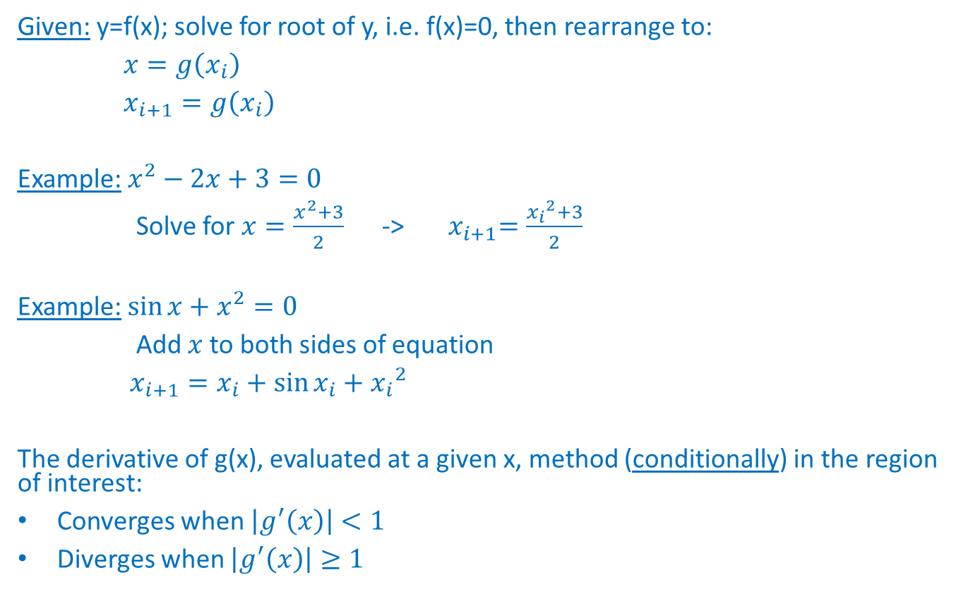
2.7 Open Methods [Simple fixed-point iteration - Revisited]
Given: y=f(x); solve for root of y, i.e. f(x)=0, then rearrange to:
$x=g\left(x_{i}\right)$
$x_{i+1}=g\left(x_{i}\right)$
Example: $x^{2}−2x+3=0$
Solve for $x=\frac{x^{2}+3}{2}$ -> ${ x}_{i+1}=\frac{{x_{i}}^{2}+3}{2}$
Example: ${\sin{x}+x}^{2}=0$
Add $x$ to both sides of equation
$x_{i+1}=x_{i}+\sin{x_{i}}+{x_{i}}^{2}$
The derivative of g(x), evaluated at a given x, method (conditionally) in the region of interest:
Converges when $\left|g^{′}\left(x\right)\right|<1$
Diverges when $\left|g^{′}\left(x\right)\right|≥1$

Slide 2
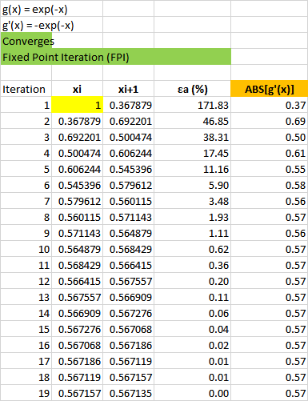
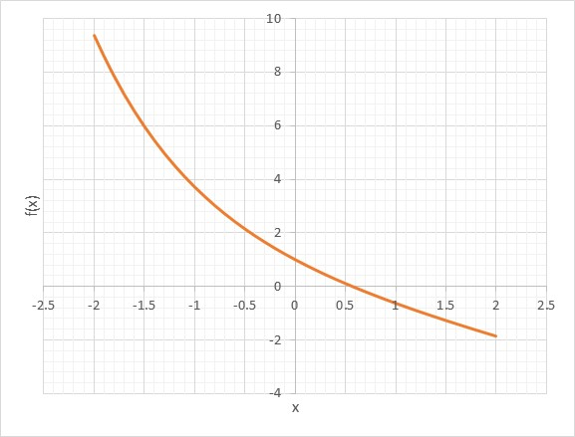
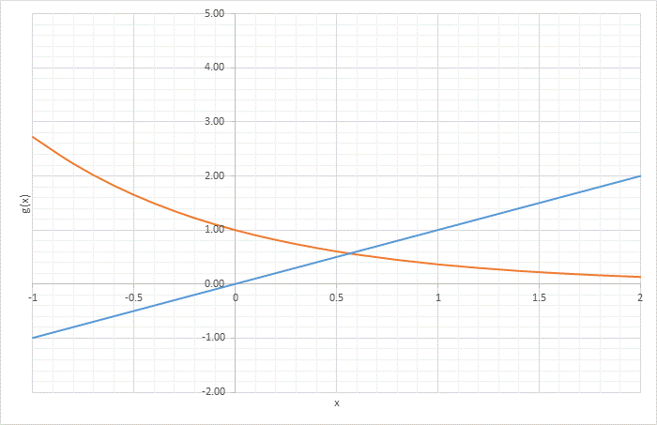

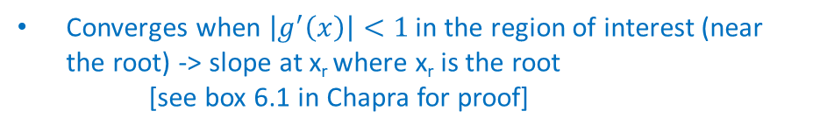
2.7 Open Methods [Simple fixed-point iteration - Revisited]
$f\left(x\right)=e^{−x}−x$ $=0$, $x_{i+1}=e^{−x_{i}}$
$ε_{a}=\left|\frac{x_{i+1}−x_{i}}{x_{i+1}}\right|∙100\%$
Converges when $\left|g^{′}\left(x\right)\right|<1$ in the region of interest (near the root) -> slope at x_{r} where x_{r} is the root
[see box 6.1 in Chapra for proof]
$\left|g^{′}\left(x\right)\right|=0.57<1$ in the region of interest (near the root)

Slide 3
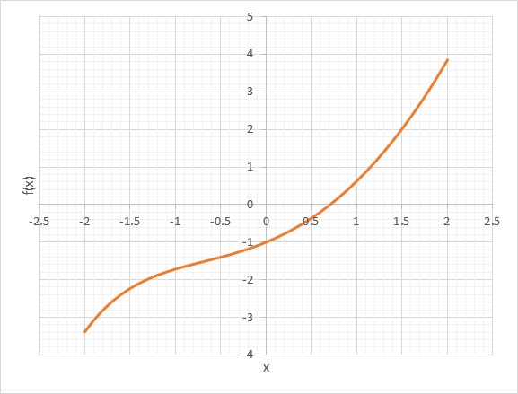

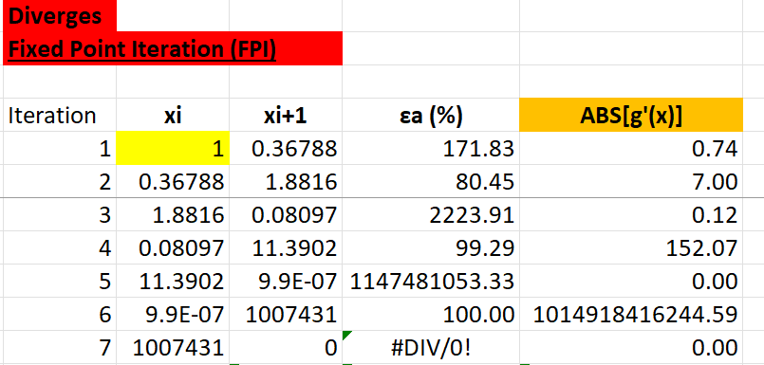
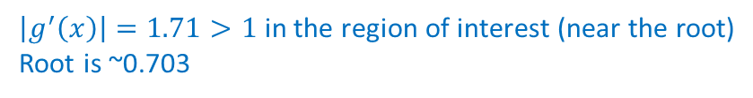


2.7 Open Methods [Simple fixed-point iteration - Revisited]
Consider the function:
f(x) = x²-e^{-x}
(divide both sides by x, then isolate x)
x_{i+1}=(e^{-xi})/x_{i}
$$ε_{a}=\left|\frac{x_{i+1}−x_{i}}{x_{i+1}}\right|∙100\%$$
$\left|g^{′}\left(x\right)\right|=1.71>1$ in the region of interest (near the root)
Root is ~0.703
Converges when $\left|g^{′}\left(x\right)\right|<1$
Diverges when $\left|g^{′}\left(x\right)\right|≥1$

Slide 4
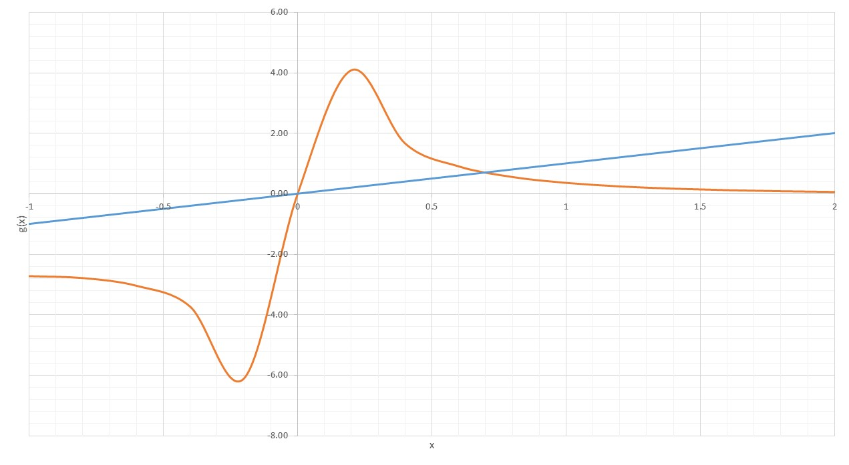

Slide 5
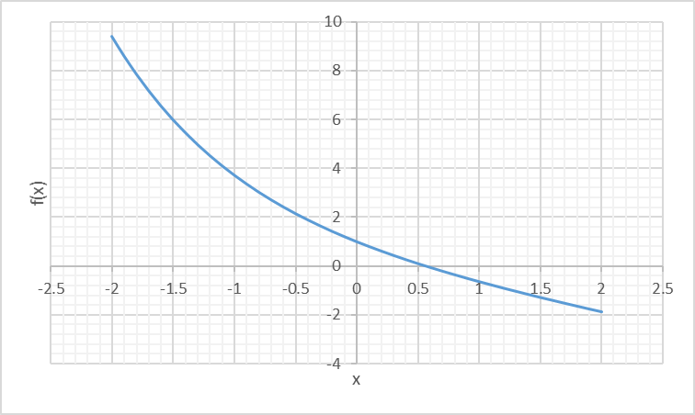
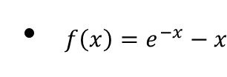


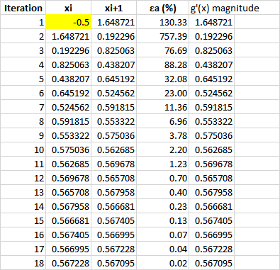

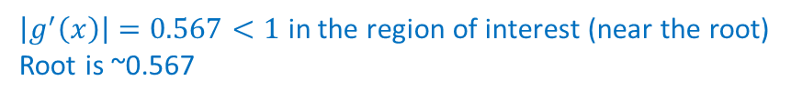
2.7 Open Methods [Simple fixed-point iteration - Revisited]
Consider the function:
$\left|g^{′}\left(x\right)\right|=0.567<1$ in the region of interest (near the root)
Root is ~0.567

Slide 6
